Slide 1











Business Overview
UNTP Explainer video series
Notes:
Welcome to the UNTP business overview video, one in a series of video explainers for the United Nations Transparency Protocol

Slide 2






Supply-chain confidence is a global imperative
Data centre
Vehicle
Battery
Cobalt
Lithium
SDGs
Notes:
Scene 1: Opening — Global context
In today's world confidence in supply chains is no longer optional. It's a global imperative.
From geopolitical tensions driving supply chain resilience needs - to rising expectations around sustainability and ethical sourcing businesses and governments are under pressure to know — not just assume — where products come from how they're made and whether they comply with growing regulatory requirements.

Slide 3

But the compliance landscape is increasingly complex
Tariff barriers
Non-Tariff barriers
Pay $$
Prove compliance
100’s of countries with
100’s of commodity rules
10’s of quotas, fee types
100,000’s of distinct tariffs
100’s of regulations, each with
100’s of rules across
100’s of commodities
Millions’s of requirements
Notes:
Scene 2: Problem escalation
At the same time, the landscape has grown dramatically more complex. Tariff regimes are increasingly fragmented, with compliance hinging on precise, verifiable evidence of origin.
Non-tariff barriers are even more intricate and burdensome, as markets now demand robust proof of compliance with environmental, social, and security requirements.
And buyers are demanding stronger proof of compliance — not just promises.

Slide 4
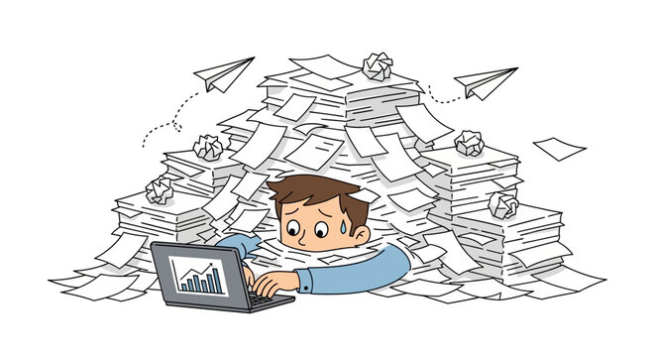
Most can only audit a few samples and hope for the best.
On average, about 1% of claims are checked
Actual audit rates from 0.01% to 10% depending on risk.
Notes:
Scene 3: Key insight (analogy)
The result is an explosion in certificates… permits… licenses… product disclosures… audit reports and so on... For any given supply chain this evidence is scattered across thousands of organisational silos - difficult to access, time-consuming to interpret, and often impossible to verify at scale.
Today, finding non-compliance risk is like searching for needles in haystacks. So, most organisations do what they can. They audit small samples, review selected documents, and hope the rest is compliant.

Slide 5
Which leaves huge risks and lost opportunities
~30% of products
Make false or misleading ESG claims
False claims
~$500Bn
Loss from tariff evasion
~$500Bn
Loss from counterfeits
Cost
$Trillions
~3M hectares
Of illegal logging per year
~100M tons
Of illegal fishing per year
~30 Million
People in forced labour
And hurt our world
Notes:
Scene 4: Consequences
But this approach leaves enormous gaps.
Globally - it means trillions of dollars in hidden supply chain cost and risk, undetected tariff evasion, counterfeit and unsafe products entering markets, fraudulent sustainability claims, and avoidable environmental and social harm.

Slide 6



Digital platforms exist but can’t scale
~ 1000 platforms
Almost zero interoperability
Cost $ and don’t solve the problem
Notes:
Scene 5: Existing solutions critique
Digital platforms have tried to solve this problem. Many attempt to centralise supply chain data and automate compliance checks. But they face a fundamental limitation.
There are thousands of disconnected platforms across different industries and regions - and no single platform will ever dominate even one complex global supply chain.

Slide 7
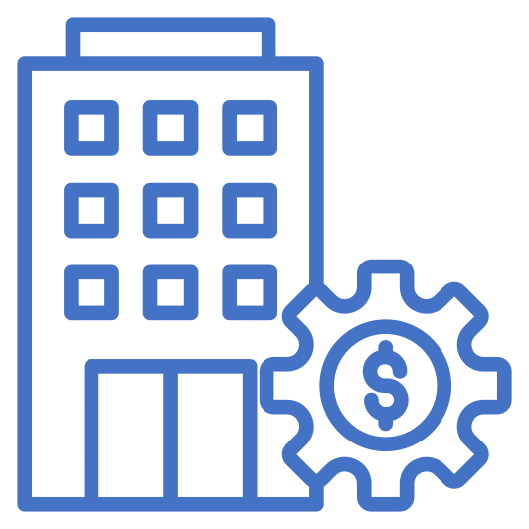



Which only adds to the burden
Buyer A
Report A
Supplier
Audit A
Buyer B
Report B
Audit B
Report C
Many suppliers report dozens of overlapping reporting & audit requirements
Audit C
Buyer C
Notes:
Scene 6: Supplier pain point
For suppliers, this creates a growing burden.
They are asked to - enter the same data into multiple systems, undergo repeated audits for similar requirements, and manage overlapping compliance schemes.
The cost of compliance is rising rapidly - without delivering the confidence that regulators, buyers, or consumers actually need.

Slide 8

The solution is a protocol, not another platform
Buyer A
Supplier
United Nations Transparency Protocol
Buyer B
Product Passport
Publish once
Discover & reuse
Facility Record
Conformity Credential
Buyer C
Traceability Event
Identity Anchor
Notes:
Scene 8: Introduce UNTP
What's missing is not another platform. What's missing is a way for all these systems and all these organisations and people to work together.
This is where the United Nations Transparency Protocol - or U N T P - comes in. It is the first international standard designed to solve this problem at its root.
UNTP is not a platform. It's an interoperability protocol - a common language and framework that allows data, evidence, and trust to flow between systems, people, organisations, and borders.
There are 5 key building blocks
Product passports carry item, batch, or model level data about products or bulk materials
Facility records carry data about the farms, mine-sites, or manufacturing plants where products are made
Conformity credentials carry independent assessments of products or facilities
Traceability events connect products and facilities to model a value-chain
Identity anchors prove the identity of all the actors in the value chain.

Slide 9



That automates compliance assessment using verifiable data
Supplier A
UNTP
Product Passport
Facility Record
Traceability Event
Buyer
Conformity Credential
Identity Anchor
Discover & verify
Supplier B
UNTP
Product Passport
Identity Resolver
Facility Record
Traceability Event
Automated Compliance Assessment
Conformity Credential
Identity Anchor
Supplier C
UNTP
Product Passport
Facility Record
Traceability Event
Conformity Credential
Identity Anchor
Notes:
Scene 10: How it works
At its heart, UNTP is built on a simple idea. That compliance should be based on continuous automated assessment of verifiable evidence - not occasional manual interpretation.
UNTP enables evidence - like certificates, audit reports, and product data to be digitally structured and cryptographically verifiable.
Data remains with its natural owner - whether that's a supplier, a certifier, or an authority. And yet it can be instantly discovered and automatically verified anywhere in the world.
A key principle in UNTP is to work with existing product, facility, and organisational identifier schemes but to make them resolvable so that, given an identifier, I can always find further data about that identifier.

Slide 10

Linked to form a decentralised, trusted network
UNTP
Product Passport
UNTP
UNTP
Facility Record
Product Passport
Traceability Event
Product Passport
Facility Record
Conformity Credential
UNTP
Facility Record
Traceability Event
Identity Anchor
Product Passport
Traceability Event
Conformity Credential
Facility Record
Conformity Credential
Traceability Event
Identity Anchor
Data centre
Identity Anchor
Vehicle
Conformity Credential
Battery
Identity Anchor
UNTP
Cobalt
Product Passport
Lithium
UNTP
Facility Record
UNTP
Product Passport
Traceability Event
Product Passport
Facility Record
Conformity Credential
Facility Record
Traceability Event
Identity Anchor
Traceability Event
Conformity Credential
Conformity Credential
Identity Anchor
Identity Anchor
Notes:
Scene 11: Decentralisation
There is no central database. No single controlling platform.
Instead - UNTP connects businesses, people, governments, certification bodies, and digital platforms into a decentralised, trusted network.

Slide 11


That can automate the assessment of every product shipment.
To continuous algorithmic assessment
From needles in haystacks
UNTP
Know what can be trusted
And where to look for risks
Notes:
Scene 12: Value proposition
This unlocks a fundamentally new capability.
The ability to automate the assessment of every transaction, every shipment, every product - not just a small sample.
Allowing organisations and regulators to narrow their enforcement focus to more targeted risks - more easily finding those needles in the haystack.

Slide 12
Reducing compliance costs for business and improving enforcement for government
Businesses can achieve meaningful improvements in margins and share value
Governments can achieve meaningful improvements in compliance and national accounts.
Benefits
Benefits
Corporate value
Value
Economic Impact
Value
Brand reputation
Improved Disclosures
Lower cost of trade
Costs
Increased investment
Costs
Revenue uplift
Transparency system
Revenue compliance
Implementaiton
Market Access
Anti-counterfeiting
Capital
National Impact
Change Management
Unit price uplift
Operational
Infrastructure
National productivity
Cost reduction
Sustainable practice
Improved compliance
Ongoing Operations
Compliance costs
Process improvement
Export market access
Capacity Building
Finance costs
Digitalisation
Certification Fees
Safety & environment
Infrastructure
Notes:
Scene 13: Benefits
For businesses this means: lower compliance costs, reduced audit duplication, faster market access…
and stronger, more resilient supply chains.
For governments and regulators: greater visibility across trade flows, more effective enforcement, reduced fraud and tariff leakage, and better outcomes for sustainability and social responsibility.

Slide 13
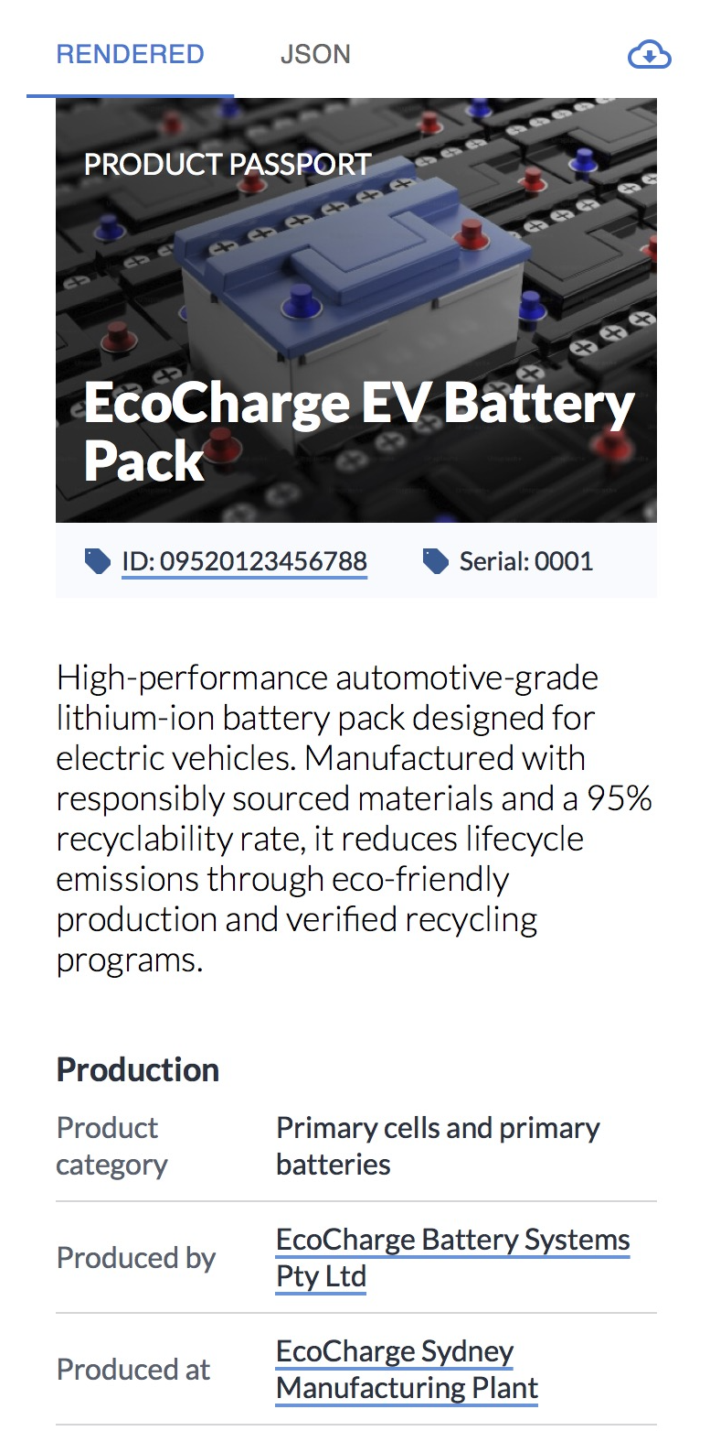
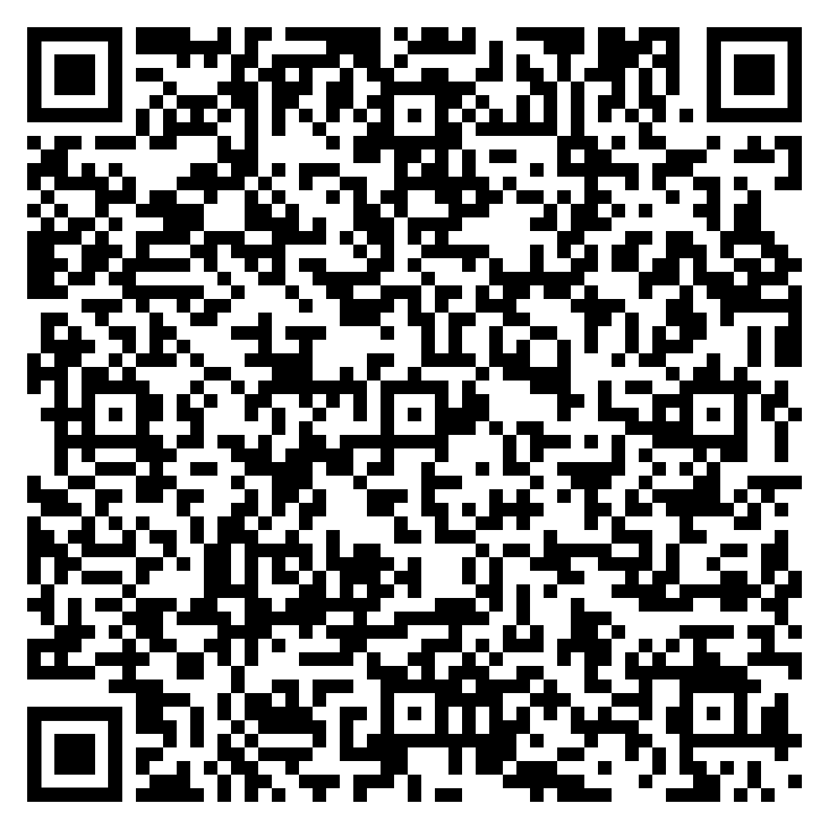
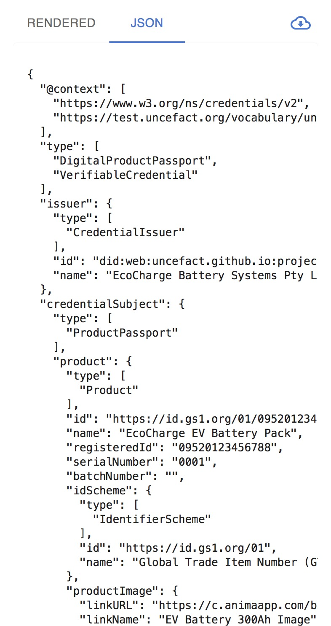
With a pragmatic paper to digital transition framework
One UNTP Credential
Humans see this
Machines see this
Notes:
Scene 15: Scalable transition
UNTP enables a smooth path to automation — every credential works for both people and systems, so paper and digital can coexist and participants can adopt at their own pace.
This means that anyone in a supply chain can implement UNTP without dependencies on the digital maturity of their customers.

Slide 14

Next, dig deeper into the details and implementation guidance
UNTP Business Overview
UNTP Technical Overview
This video
UNTP Implementer guidance
UNTP Technical details
Other UNTP videos
Notes:
Scene 16: Closing
In short, UNTP creates the foundation for a future where: trust is built into data, compliance is automated, and transparency scales globally.
It is the lowest-cost, most scalable path to achieving supply chain resilience, integrity, and sustainability at a global level.
Explore our other videos to understand how the protocol actually works or what it takes to implement.

Slide 15
Thank you!
Steve Capell
Project Lead
UNECE
Date April 2026

